Slide 1
Time and Space Tradeoffs
Notes:
To create Em dash above headline:
Same size and weight as the headline and set using a soft return.
PC: Em dash (—): Alt+Ctrl+ - (minus)
Mac: Em dash (—): Shift+Alt/Option+hyphen

Slide 2
Learning objectives
Understand space-time tradeoffs in algorithm design.
Two of the paradigms:
Input enhancement (sort by counting)
Pre-structuring (hashing)

Slide 3
Agenda
Overview
Sort by Counting
Hash Tables
Separate Chaining Hashing
Open Address Hashing
Summary

Slide 4
1. Overview
Notes:
To create Em dash above headline:
Same size and weight as the headline and set using a soft return.
PC: Em dash (—): Alt+Ctrl+ - (minus)
Mac: Em dash (—): Shift+Alt/Option+hyphen

Slide 5
Time & Space Trade offs
We can gain time by using more space – whole idea behind this lecture.
In this lecture, we discuss two varieties of Time & Space trade offs:
Input Enhancement
Pre-structuring

Slide 6
Time & Space Trade-offs
Input Enhancement – pre-process the input to store extra information that will accelerate the solving of the problem.
counting sorts
Pre-structuring – use extra space to make accessing its elements easier or faster.
hashing

Slide 7
2. Sort by Counting
Notes:
To create Em dash above headline:
Same size and weight as the headline and set using a soft return.
PC: Em dash (—): Alt+Ctrl+ - (minus)
Mac: Em dash (—): Shift+Alt/Option+hyphen

Slide 8
Count-based Sorting
When sorting a list with many repeated values, can we do better than the sorts we have seen?
Rough idea: Imagine we have array with three unique values, 1, 2, 3
Imagine if our array consist of 2,1,2,3,1
If I arrange the array with the 1s, then the 2s, then the 3s, then I have sorted the array (1,1,2,2,3).
Distribution sort does exactly this, in a smart way.

Slide 9
Distribution Sorting
Use an auxiliary table to store the frequency of each possible element value (indexed by distinct elements).
Compute the cumulative frequency (how many elements in array have a value in array).
Use cumulative frequency count to copy elements, in sorted order, to a new array. The cumulative counts indicate which position to copy the elements to.

Slide 10
Distribution Sorting
We copy the elements in original array going from right to left (in order to have stable sorting).
Consider the array A = {13, 11, 12, 13, 12, 12}
Array Values | 11 12 13
Frequencies | 1 3 2
Cumulative Frequencies | 1 4 6
A = {11, 12, 12, 12, 13, 13}

Slide 11
Distribution Sorting
12 | 4 | 12 | 9 | 12 | 15 | 9 | 4 | 9
4 | 9 | 12 | 15
0 | 0 | 0 | 0
1 | 2 | 3 | 4 | 5 | 6 | 7 | 8 | 9

Slide 12
Distribution Sorting
12 | 4 | 12 | 9 | 12 | 15 | 9 | 4 | 9
4 | 9 | 12 | 15
0 | 0 | 1 | 0
1 | 2 | 3 | 4 | 5 | 6 | 7 | 8 | 9

Slide 13
Distribution Sorting
12 | 4 | 12 | 9 | 12 | 15 | 9 | 4 | 9
4 | 9 | 12 | 15
1 | 0 | 1 | 0
1 | 2 | 3 | 4 | 5 | 6 | 7 | 8 | 9

Slide 14
Distribution Sorting
12 | 4 | 12 | 9 | 12 | 15 | 9 | 4 | 9
4 | 9 | 12 | 15
1 | 0 | 2 | 0
1 | 2 | 3 | 4 | 5 | 6 | 7 | 8 | 9

Slide 15
Distribution Sorting
12 | 4 | 12 | 9 | 12 | 15 | 9 | 4 | 9
4 | 9 | 12 | 15
1 | 1 | 2 | 0
1 | 2 | 3 | 4 | 5 | 6 | 7 | 8 | 9

Slide 16
Distribution Sorting
12 | 4 | 12 | 9 | 12 | 15 | 9 | 4 | 9
4 | 9 | 12 | 15
1 | 1 | 3 | 0
1 | 2 | 3 | 4 | 5 | 6 | 7 | 8 | 9

Slide 17
Distribution Sorting
12 | 4 | 12 | 9 | 12 | 15 | 9 | 4 | 9
4 | 9 | 12 | 15
1 | 1 | 3 | 1
1 | 2 | 3 | 4 | 5 | 6 | 7 | 8 | 9

Slide 18
Distribution Sorting
12 | 4 | 12 | 9 | 12 | 15 | 9 | 4 | 9
4 | 9 | 12 | 15
1 | 2 | 3 | 1
1 | 2 | 3 | 4 | 5 | 6 | 7 | 8 | 9

Slide 19
Distribution Sorting
12 | 4 | 12 | 9 | 12 | 15 | 9 | 4 | 9
4 | 9 | 12 | 15
2 | 2 | 3 | 1
1 | 2 | 3 | 4 | 5 | 6 | 7 | 8 | 9

Slide 20
Distribution Sorting
12 | 4 | 12 | 9 | 12 | 15 | 9 | 4 | 9
4 | 9 | 12 | 15
2 | 3 | 3 | 1
1 | 2 | 3 | 4 | 5 | 6 | 7 | 8 | 9

Slide 21
Distribution Sorting
12 | 4 | 12 | 9 | 12 | 15 | 9 | 4 | 9
4 | 9 | 12 | 15
2 | 3 | 3 | 1
1 | 2 | 3 | 4 | 5 | 6 | 7 | 8 | 9

Slide 22
Distribution Sorting
12 | 4 | 12 | 9 | 12 | 15 | 9 | 4 | 9
4 | 9 | 12 | 15
2 | 3 | 3 | 1
1 | 2 | 3 | 4 | 5 | 6 | 7 | 8 | 9
4 | 4 | 9 | 9 | 9 | 12 | 12 | 12 | 15

Slide 23
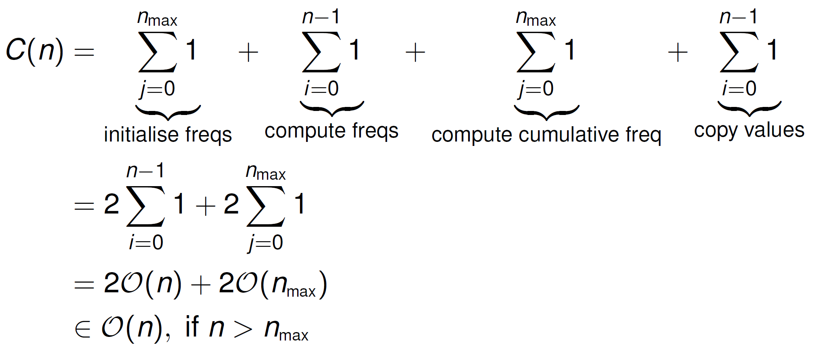

Distribution Sorting Analysis
The worst-case analysis for distribution sorting is:
The algorithm also uses an additional $O\left(n\right)+O(n_{max})$ space

Slide 24
3. Hash Tables

Slide 25
Set ADT
Recall the definition of a set, where all the keys are unique. (Note this applies to maps also, where we have key->value pairs).
What data structures can we use to implement a Set ADT? For example:
List
Tree (balanced)
Array

Slide 26
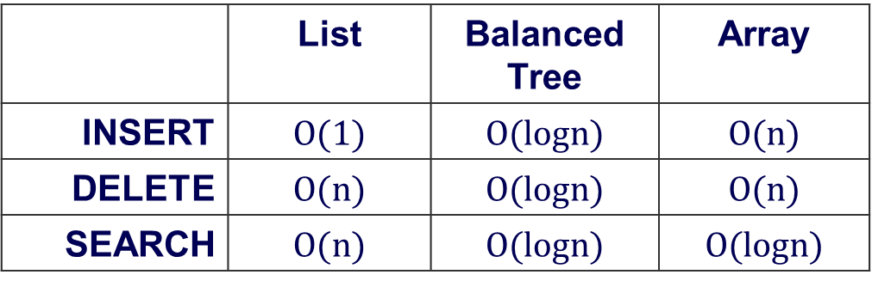
Set ADT
What is the average case time complexities of INSERT, DELETE and SEARCH?
Is it possible to achieve better efficiency?
 | List | Balanced Tree | Array
INSERT | $$O(1)$$ | $$O(logn)$$ | $$O(n)$$
DELETE | $$O(n)$$ | $$O(logn)$$ | $$O(n)$$
SEARCH | $$O(n)$$ | $$O(logn)$$ | $$O(logn)$$
Notes:
Search, insert, delete are O(1) on average (O(n) worst)

Slide 27
Hash Tables
If we have an array holding keys, and O(1) method to map a key to a position in this array, we can improve on previous average case complexities
This is the idea behind hash tables
Array is called hash table
Mapping method called hash function

Slide 28
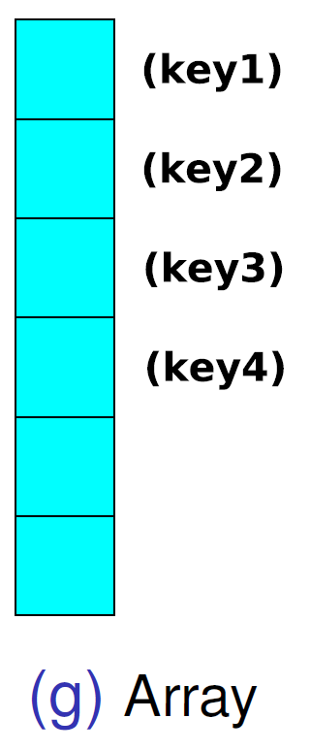
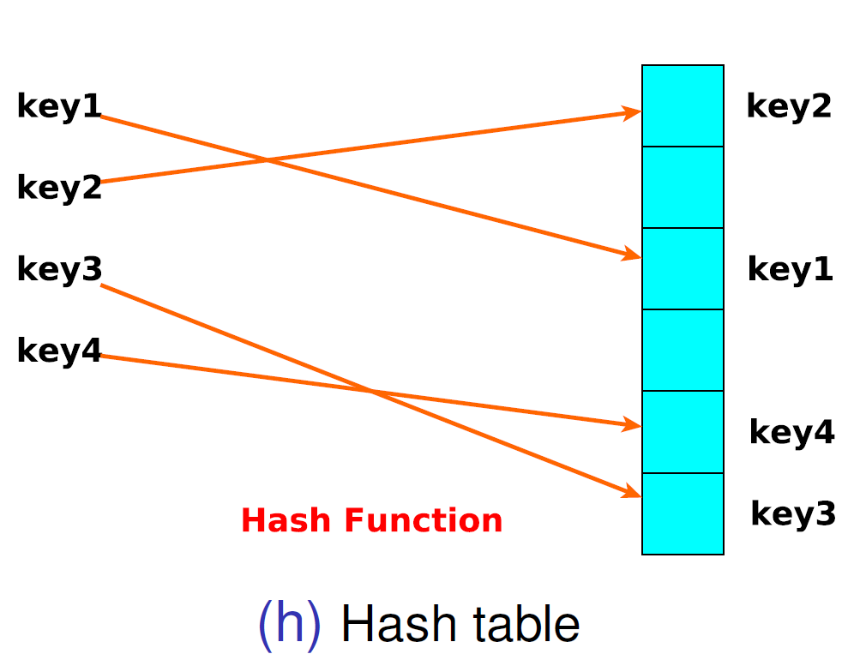
Hash Tables – Illustration

Slide 29
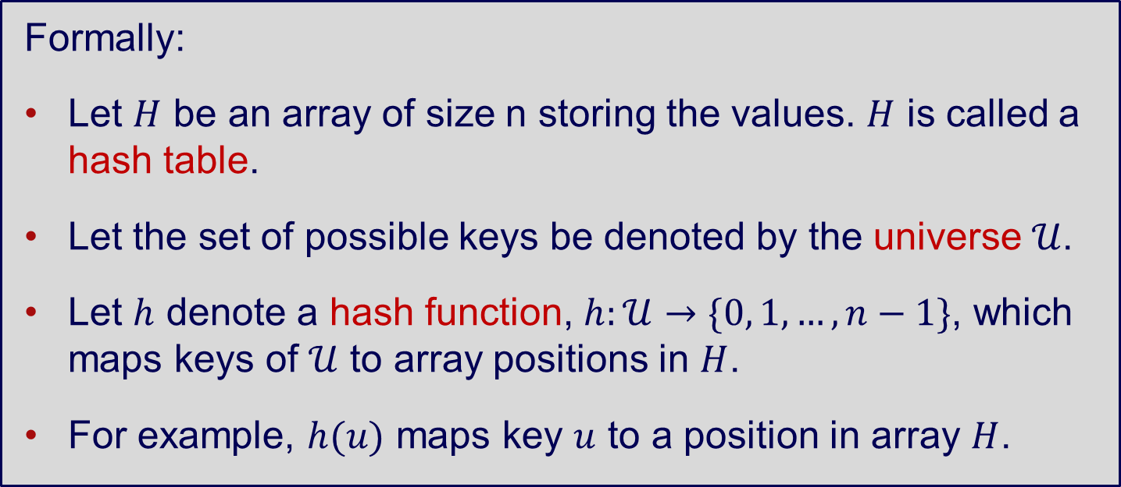
Hash Tables – Definitions
Formally:
Let $H$ be an array of size n storing the values. $H$ is called a hash table.
Let the set of possible keys be denoted by the universe $𝒰$.
Let $h$ denote a hash function, $h:𝒰→\{0, 1, …, n−1\}$, which maps keys of $𝒰$ to array positions in $H$.
For example, $h(u)$ maps key $u$ to a position in array $H$.

Slide 30
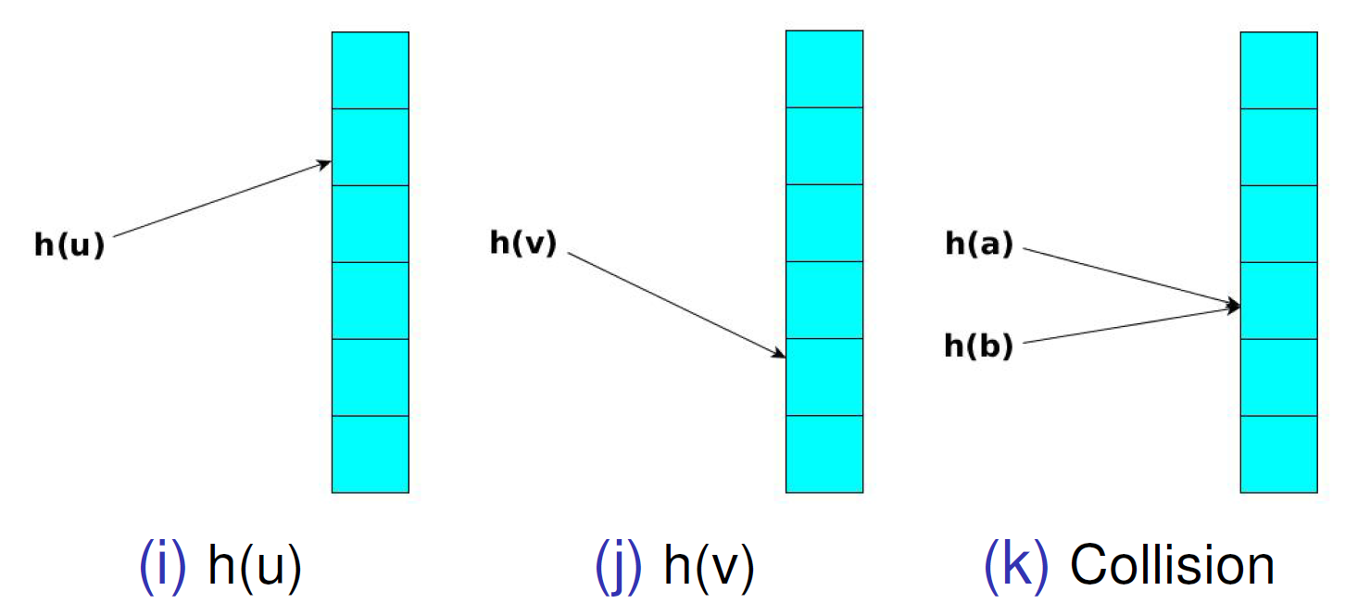
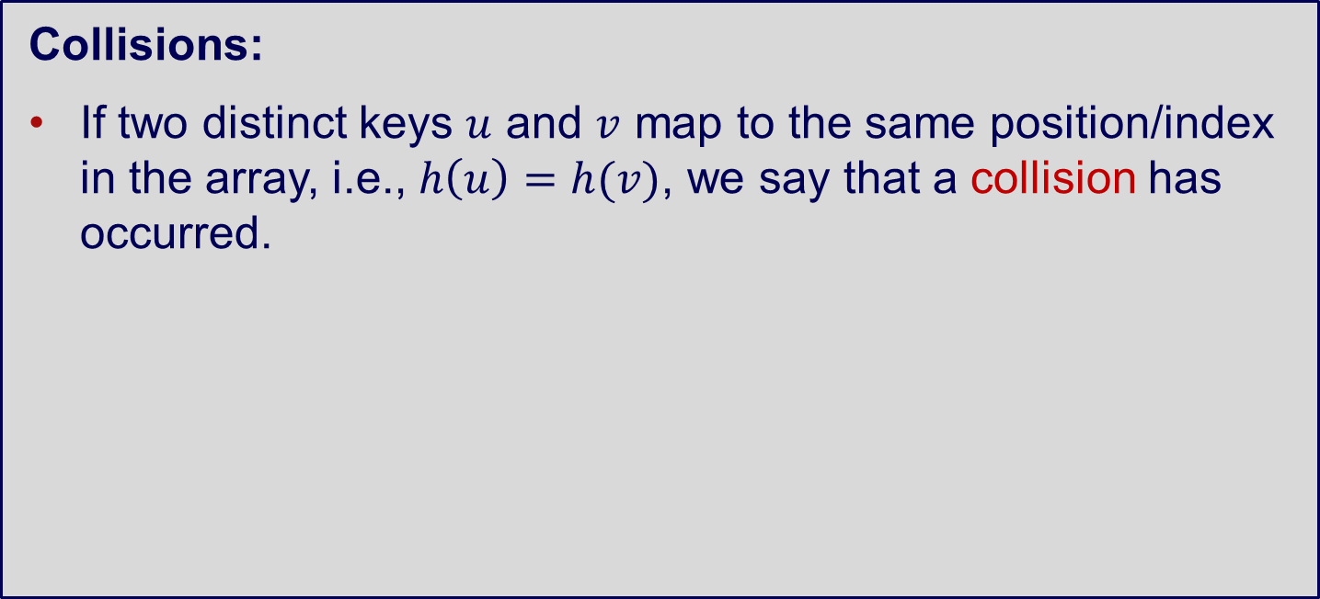
Hash Tables – Collisions
Collisions:
If two distinct keys $u$ and $v$ map to the same position/index in the array, i.e., $h\left(u\right)=h(v)$, we say that a collision has occurred.

Slide 31
Hash Tables – Choices
When designing the Hash Tables, we consider:
Hash function
Size of hash table
Collision resolution

Slide 32
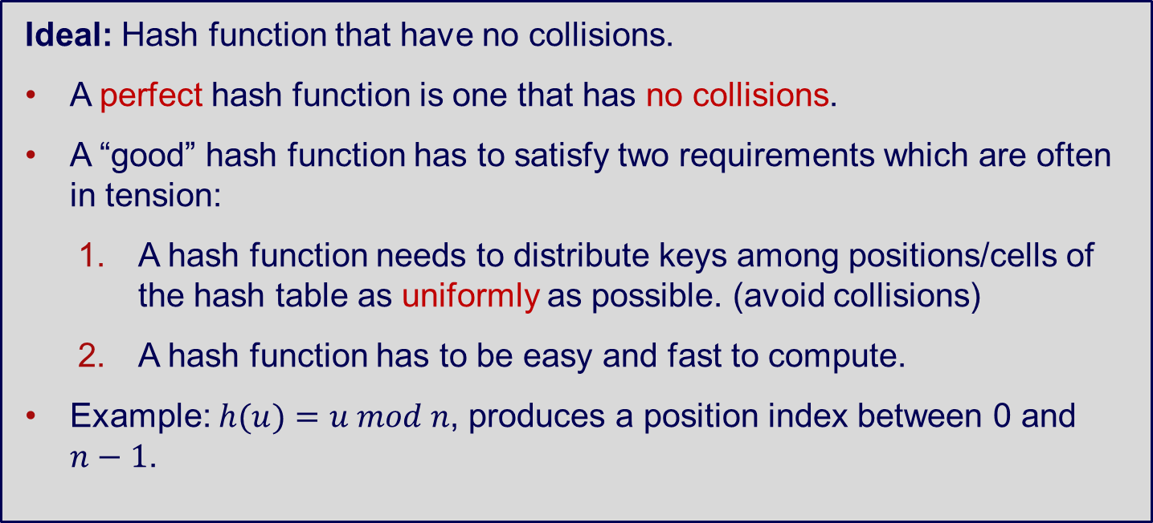
Hash Tables – Hash Functions
Ideal: Hash function that have no collisions.
A perfect hash function is one that has no collisions.
A “good” hash function has to satisfy two requirements which are often in tension:
A hash function needs to distribute keys among positions/cells of the hash table as uniformly as possible. (avoid collisions)
A hash function has to be easy and fast to compute.
Example: $h(u)=u mod n$, produces a position index between 0 and $n−1$.

Slide 33
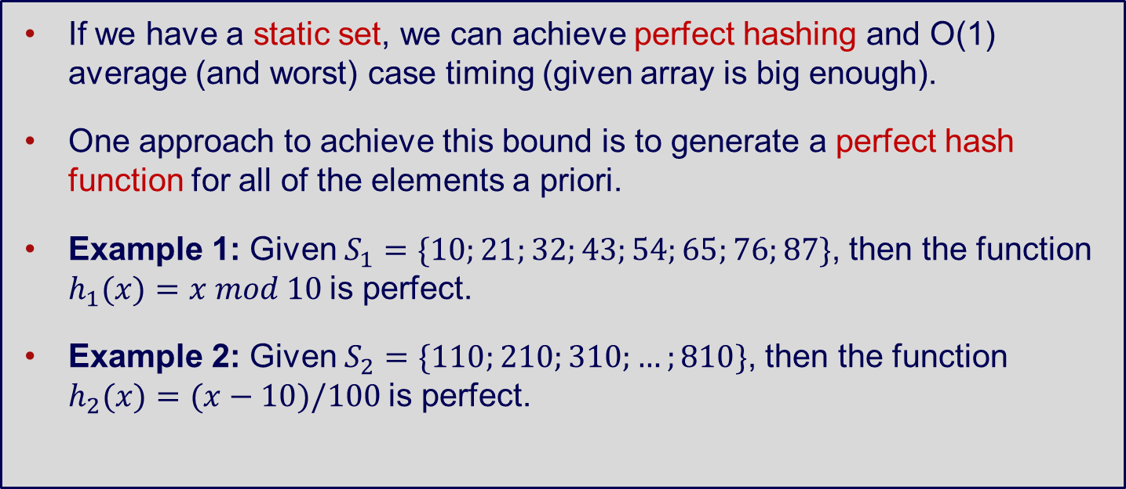
Perfect Hash Functions (static set)
If we have a static set, we can achieve perfect hashing and O(1) average (and worst) case timing (given array is big enough).
One approach to achieve this bound is to generate a perfect hash function for all of the elements a priori.
Example 1: Given $S_{1}=\{10;21;32;43;54;65;76;87\}$, then the function $h_{1}(x)=x mod 10$is perfect.
Example 2: Given $S_{2}=\{110;210;310;…;810\}$, then the function $h_{2}(x)=(x−10)/100$is perfect.

Slide 34
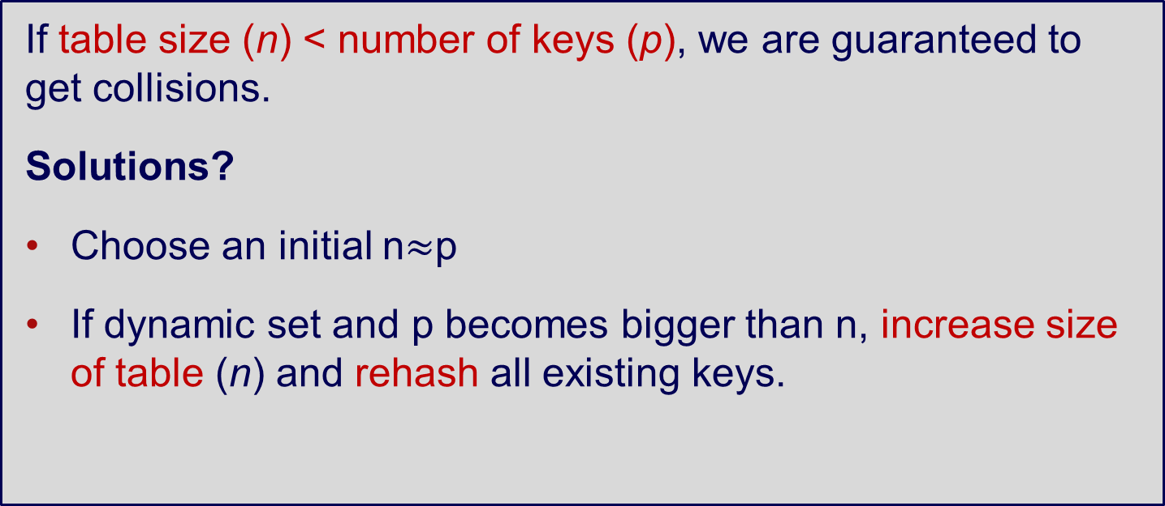
Size of Hash Table
If table size (n) < number of keys (p), we are guaranteed to get collisions.
Solutions?
Choose an initial n$≈$p
If dynamic set and p becomes bigger than n, increase size of table (n) and rehash all existing keys.

Slide 35
Collision Resolution
There are two major approaches to handle collisions:
Separate Chaining Hashing
Open Address Hashing

Slide 36
3a. Separate Chaining Hashing

Slide 37
Separate Chaining Hashing
What is Separate Chaining Hashing?
Hashing that involves chains
Separate chains

Slide 38
Separate Chaining Hashing
Allow more than one key to be stored in a position of the hash table.
Each position has a linked list, that stores all the keys hashed to that position.
For completeness, if no key hashed to a position, set linked list pointer to null.

Slide 39
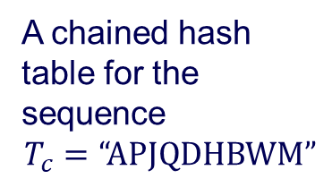
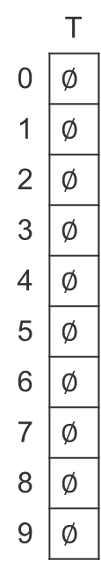
Separate Chaining Hashing – Example
 | T
0 | $$∅$$
1 | $$∅$$
2 | $$∅$$
3 | $$∅$$
4 | $$∅$$
5 | $$∅$$
6 | $$∅$$
7 | $$∅$$
8 | $$∅$$
9 | $$∅$$
A chained hash table for the sequence
$$T_{c}=“APJQDHBWM”$$

Slide 40
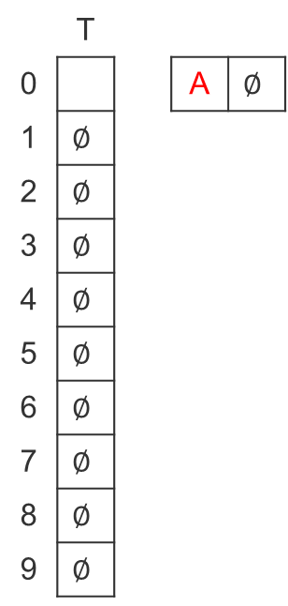
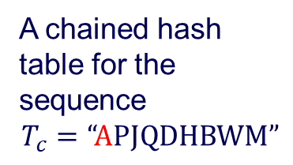
Separate Chaining Hashing – Example
 | T
0 |  |  | A | $$∅$$
1 | $$∅$$
2 | $$∅$$
3 | $$∅$$
4 | $$∅$$
5 | $$∅$$
6 | $$∅$$
7 | $$∅$$
8 | $$∅$$
9 | $$∅$$
A chained hash table for the sequence
$$T_{c}=“APJQDHBWM”$$
Notes:
A = 65 mod 10

Slide 41
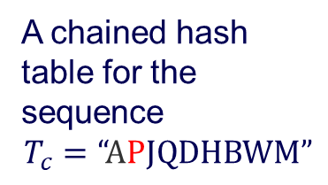
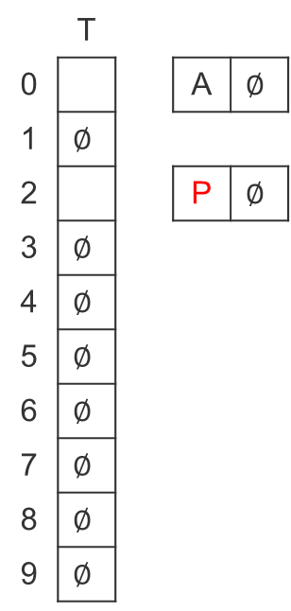
Separate Chaining Hashing – Example
 | T
0 |  |  | A | $$∅$$
1 | $$∅$$
2 |  |  | P | $$∅$$
3 | $$∅$$
4 | $$∅$$
5 | $$∅$$
6 | $$∅$$
7 | $$∅$$
8 | $$∅$$
9 | $$∅$$
A chained hash table for the sequence
$$T_{c}=“APJQDHBWM”$$

Slide 42
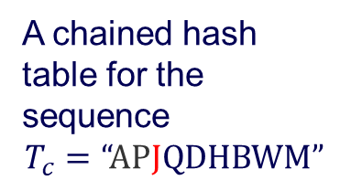
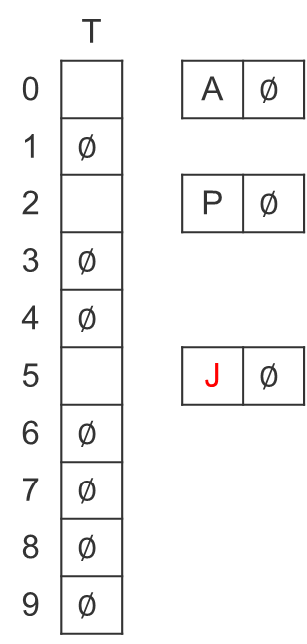
Separate Chaining Hashing – Example
 | T
0 |  |  | A | $$∅$$
1 | $$∅$$
2 |  |  | P | $$∅$$
3 | $$∅$$
4 | $$∅$$
5 |  |  | J | $$∅$$
6 | $$∅$$
7 | $$∅$$
8 | $$∅$$
9 | $$∅$$
A chained hash table for the sequence
$$T_{c}=“APJQDHBWM”$$

Slide 43
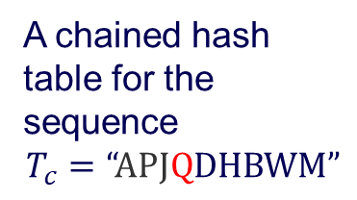
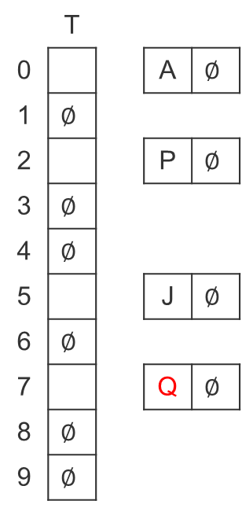
Separate Chaining Hashing – Example
 | T
0 |  |  | A | $$∅$$
1 | $$∅$$
2 |  |  | P | $$∅$$
3 | $$∅$$
4 | $$∅$$
5 |  |  | J | $$∅$$
6 | $$∅$$
7 |  |  | Q | $$∅$$
8 | $$∅$$
9 | $$∅$$
A chained hash table for the sequence
$$T_{c}=“APJQDHBWM”$$

Slide 44
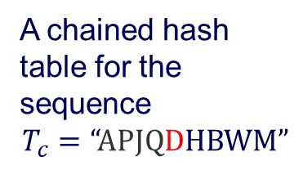
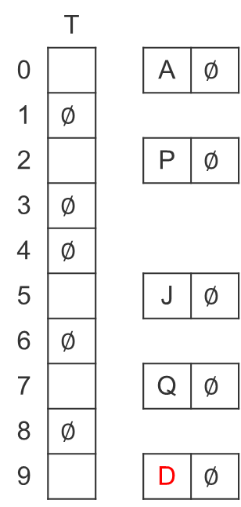
Separate Chaining Hashing – Example
 | T
0 |  |  | A | $$∅$$
1 | $$∅$$
2 |  |  | P | $$∅$$
3 | $$∅$$
4 | $$∅$$
5 |  |  | J | $$∅$$
6 | $$∅$$
7 |  |  | Q | $$∅$$
8 | $$∅$$
9 |  |  | D | $$∅$$
A chained hash table for the sequence
$$T_{c}=“APJQDHBWM”$$

Slide 45
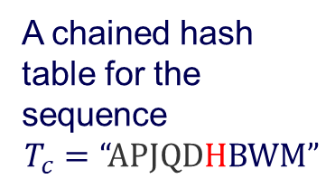
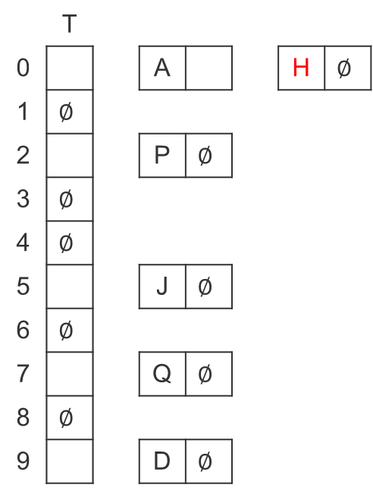
Separate Chaining Hashing – Example
 | T
0 |  |  | A |  |  | H | $$∅$$
1 | $$∅$$
2 |  |  | P | $$∅$$
3 | $$∅$$
4 | $$∅$$
5 |  |  | J | $$∅$$
6 | $$∅$$
7 |  |  | Q | $$∅$$
8 | $$∅$$
9 |  |  | D | $$∅$$
A chained hash table for the sequence
$$T_{c}=“APJQDHBWM”$$

Slide 46
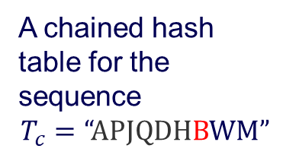
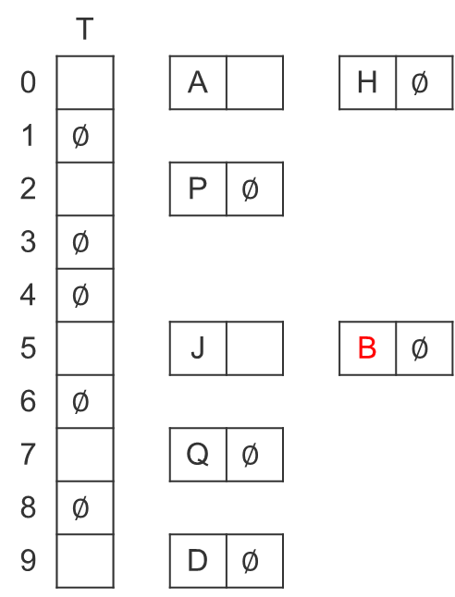
Separate Chaining Hashing – Example
 | T
0 |  |  | A |  |  | H | $$∅$$
1 | $$∅$$
2 |  |  | P | $$∅$$
3 | $$∅$$
4 | $$∅$$
5 |  |  | J |  |  | B | $$∅$$
6 | $$∅$$
7 |  |  | Q | $$∅$$
8 | $$∅$$
9 |  |  | D | $$∅$$
A chained hash table for the sequence
$$T_{c}=“APJQDHBWM”$$

Slide 47
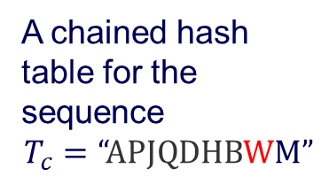
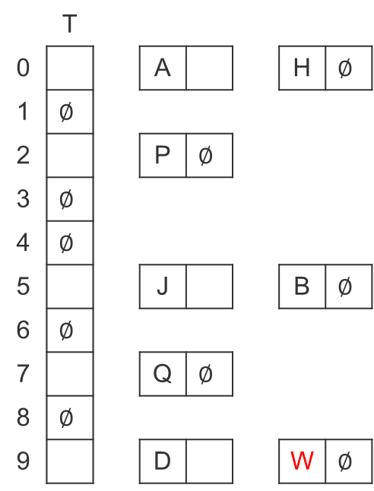
Separate Chaining Hashing – Example
 | T
0 |  |  | A |  |  | H | $$∅$$
1 | $$∅$$
2 |  |  | P | $$∅$$
3 | $$∅$$
4 | $$∅$$
5 |  |  | J |  |  | B | $$∅$$
6 | $$∅$$
7 |  |  | Q | $$∅$$
8 | $$∅$$
9 |  |  | D |  |  | W | $$∅$$
A chained hash table for the sequence
$$T_{c}=“APJQDHBWM”$$

Slide 48
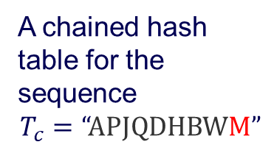
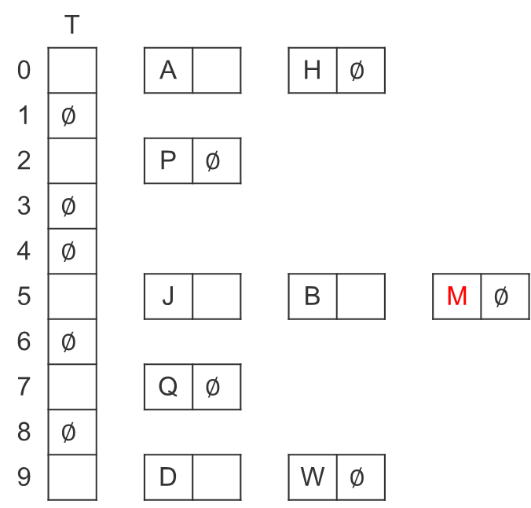
Separate Chaining Hashing – Example
 | T
0 |  |  | A |  |  | H | $$∅$$
1 | $$∅$$
2 |  |  | P | $$∅$$
3 | $$∅$$
4 | $$∅$$
5 |  |  | J |  |  | B |  |  | M | $$∅$$
6 | $$∅$$
7 |  |  | Q | $$∅$$
8 | $$∅$$
9 |  |  | D |  |  | W | $$∅$$
A chained hash table for the sequence
$$T_{c}=“APJQDHBWM”$$

Slide 49
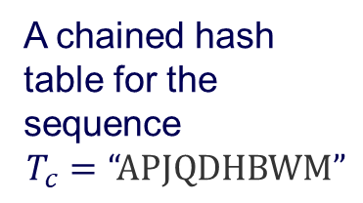
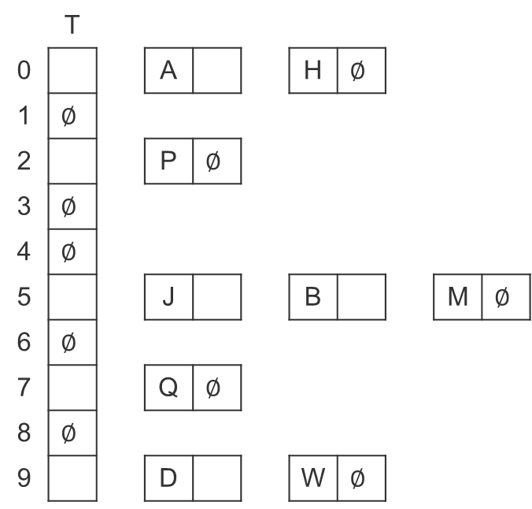
Separate Chaining Hashing – Example
 | T
0 |  |  | A |  |  | H | $$∅$$
1 | $$∅$$
2 |  |  | P | $$∅$$
3 | $$∅$$
4 | $$∅$$
5 |  |  | J |  |  | B |  |  | M | $$∅$$
6 | $$∅$$
7 |  |  | Q | $$∅$$
8 | $$∅$$
9 |  |  | D |  |  | W | $$∅$$
A chained hash table for the sequence
$$T_{c}=“APJQDHBWM”$$

Slide 50
Separate Chaining Hashing – Cost
INSERT in O(1) worst-case by inserting a new element at the front or end of the list depending on the implementation.
DELETE proportional to length of list.
MEMBER proportional to length of list.
Average case time is O(1) for all operations, assuming simple uniform hashing (distribute keys uniformly).

Slide 51
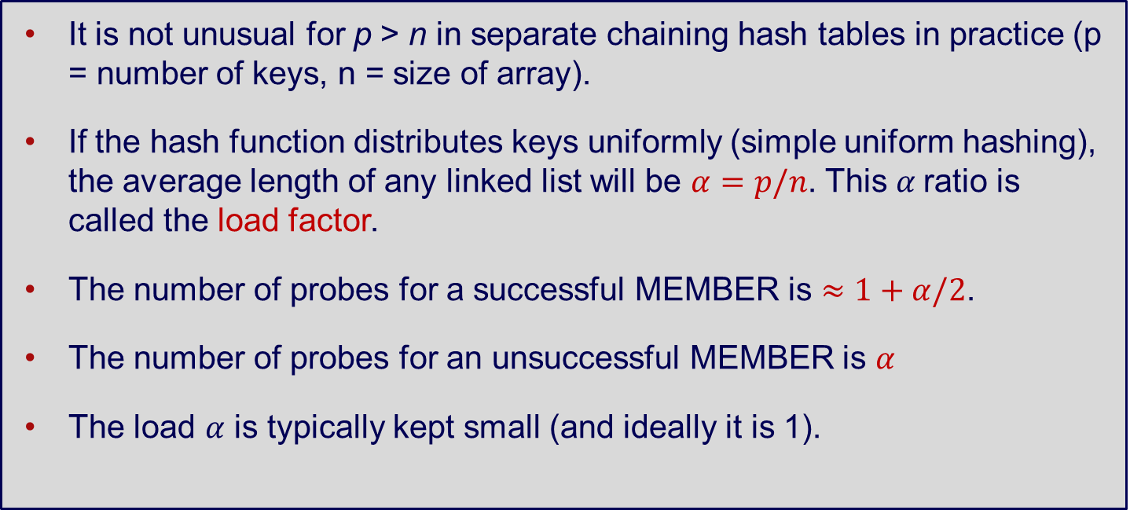
Separate Chaining Hashing – Analysis
It is not unusual for p > n in separate chaining hash tables in practice (p = number of keys, n = size of array).
If the hash function distributes keys uniformly (simple uniform hashing), the average length of any linked list will be $α=p/n$. This $α$ratio is called the load factor.
The number of probes for a successful MEMBER is $≈1+α/2$.
The number of probes for an unsuccessful MEMBER is $α$
The load $α$ is typically kept small (and ideally it is 1).

Slide 52
3b. Open Address Hashing

Slide 53
Open Address Hashing – Overview
Open address hashing is an alternative method to handle collisions.
Each cell in the base array can store exactly one item.
Linear probing - store the item in the next free cell.
Double hashing - use a second hash function to compute the increment.

Slide 54

OAH – Linear Probing
For the sequence $T_{c}=“APJQDHBWM”$, construct an open addressing hash table.
H(A)

Slide 55

OAH – Linear Probing
For the sequence $T_{c}=“APJQDHBWM”$, construct an open addressing hash table.
A
 |  | H(P)

Slide 56

OAH – Linear Probing
For the sequence $T_{c}=“APJQDHBWM”$, construct an open addressing hash table.
A |  | P | J |  |  | Q
 |  |  |  |  |  |  |  |  | H(D)

Slide 57

OAH – Linear Probing
For the sequence $T_{c}=“APJQDHBWM”$, construct an open addressing hash table.
A |  | P | J |  |  | Q |  |  | D
H(H)

Slide 58

OAH – Linear Probing
For the sequence $T_{c}=“APJQDHBWM”$, construct an open addressing hash table.
A | H | P | J |  |  | Q
 |  |  | H(B)

Slide 59

OAH – Linear Probing
For the sequence $T_{c}=“APJQDHBWM”$, construct an open addressing hash table.
A | H | P | J | B |  | Q
 |  |  | H(W)

Slide 60

OAH – Linear Probing
For the sequence $T_{c}=“APJQDHBWM”$, construct an open addressing hash table.
A | H | P | J | B | W | Q |  |  | D
 |  |  |  |  |  |  |  |  | H(M)

Slide 61

OAH – Linear Probing
For the sequence $T_{c}=“APJQDHBWM”$, construct an open addressing hash table.
A | H | P | J | B | W | Q | M |  | D

Slide 62
OAH – Double Hashing
Double hashing uses two hash functions:
one is to determine the initial position (same as linear probing)
the other to determine the size of interval to step (linear probing always has interval of 1)

Slide 63
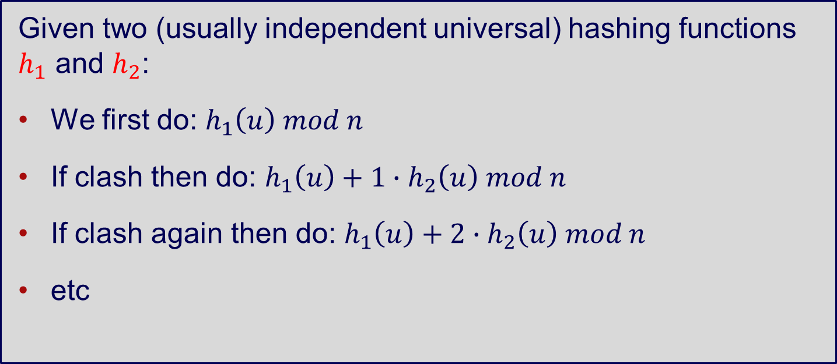
OAH – Double Hashing
Given two (usually independent universal) hashing functions $h_{1}$ and $h_{2}$:
We first do: $h_{1}\left(u\right) mod n$
If clash then do: $h_{1}\left(u\right)+1∙h_{2}\left(u\right) mod n$
If clash again then do: $h_{1}\left(u\right)+2∙h_{2}\left(u\right) mod n$
etc

Slide 64
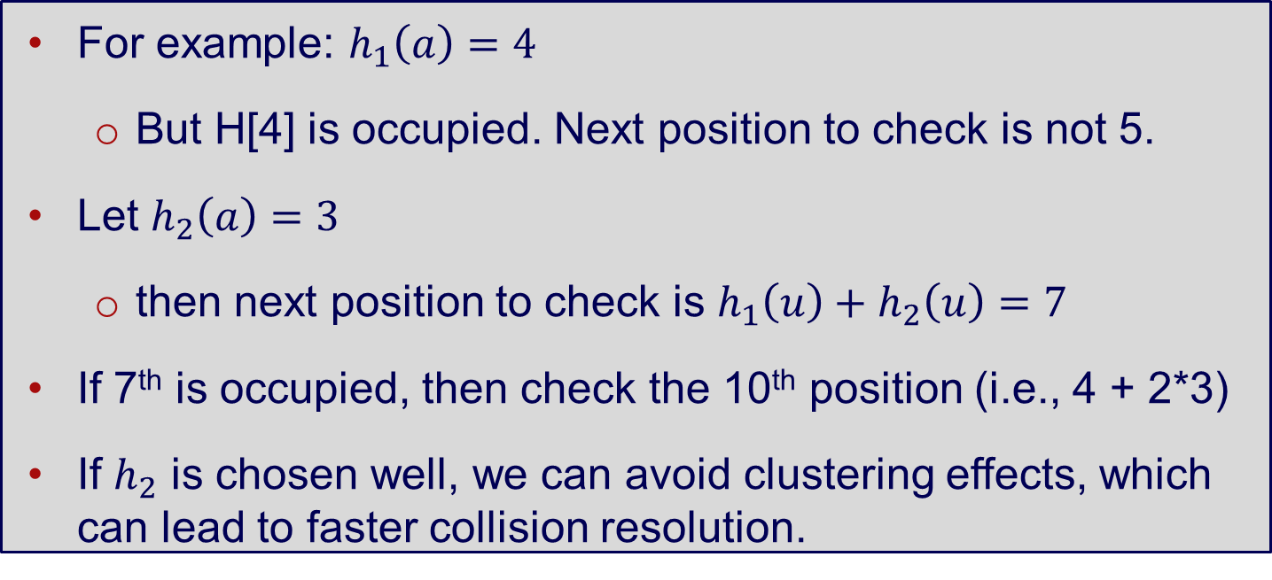
OAH – Double Hashing
For example: $h_{1}\left(a\right)=4$
But H[4] is occupied. Next position to check is not 5.
Let $h_{2}\left(a\right)=3$
then next position to check is $h_{1}\left(u\right)+h_{2}\left(u\right)=7$
If 7th is occupied, then check the 10th position (i.e., 4 + 2*3)
If $h_{2}$ is chosen well, we can avoid clustering effects, which can lead to faster collision resolution.

Slide 65
Double Hashing – Comments
Difficult to analyse the complexity of successful and unsuccessful searches (depends on load factor)
Empirically shown double hashing performs better than linear probing, especially when table is more full.
The cost for second hashing is O(1) and we can reduce the chance of collision

Slide 66
Hashing Example
Message Digest: Cryptographic hash functions produce an output from which reaching the input is close to impossible. This property of hash functions is called irreversibility.
Suppose you have to store your files on any of the cloud services available. You have to be sure that the files that you store are not tampered by any third party. You do it by computing “hash” of that file using a Cryptographic hash algorithm e.g. SHA 256. The hash thus computed has a maximum size of 32 bytes. So a computing the hash of large number of files will not be a problem. You save these hashes on your local machine
Now, when you download the files, you compute the hash again. Then you match it with the previous hash computed. If anybody tampers with the file, the hash value of the file will definitely change. Tampering the file without changing the hash is nearly impossible.

Slide 67
Hashing Example
Password Verification - Cryptographic hash functions are very commonly used in password verification. Let’s understand this using an Example:
When you use any online website which requires a user login, you enter your E-mail and password to authenticate that the account you are trying to use belongs to you. When the password is entered, a hash of the password is computed which is then sent to the server for verification of the password. The passwords stored on the server are actually computed hash values of the original passwords. This is done to ensure that when the password is sent from client to server, no sniffing is there.

Slide 68
Hashing Examples
Data Structures - Various programming languages have hash table based Data Structures. The basic idea is to create a key-value pair where key is supposed to be a unique value, whereas value can be same for different keys. This implementation is seen in unordered_set & unordered_map in C++, HashSet & HashMap in java, dict in python etc.
Compiler Operation - The keywords of a programming language are processed differently than other identifiers. To differentiate between the keywords of a programming language(if, else, for, return etc.) and other identifiers and to successfully compile the program, the compiler stores all these keywords in a set which is implemented using a hash table

Slide 69
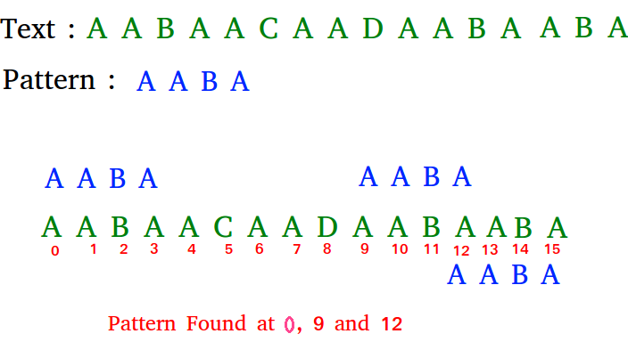
Hashing Example
One of the most famous applications of hashing is the Rabin-Karp algorithm. Which is string-searching algorithm which uses hashing to find any one set of patterns in a string. A practical application of this algorithm is detecting plagiarism.
To find a single match of a single pattern, the expected time of the algorithm is linear in the combined length of the pattern and text, although its worst-case time complexity is the product of the two lengths. To find multiple matches, the expected time is linear in the input lengths, plus the combined length of all the matches, which could be greater than linear.
The Aho–Corasick algorithm matches uses a finite state machine to match all the strings simultaneously. The complexity of the algorithm is linear in the length of the strings plus the length of the searched text plus the number of output matches.

Slide 70
Applications of Hashing
Checksums and signatures:
https://www.youtube.com/watch?v=b4b8ktEV4Bg
Locality sensitive hashing:
https://www.youtube.com/watch?v=Ha7_Vf2eZvQ

Slide 71
Wrapping things up

Slide 72
Summary
The two types of space-time tradeoffs discussed:
input enhancement
preprocess input and store relevant information that speeds up solving the problem.
e.g., distribution sorting
prestructuring
construct data structures (space) that have faster or more flexible access to data.
e.g., hashing

